Slide 1
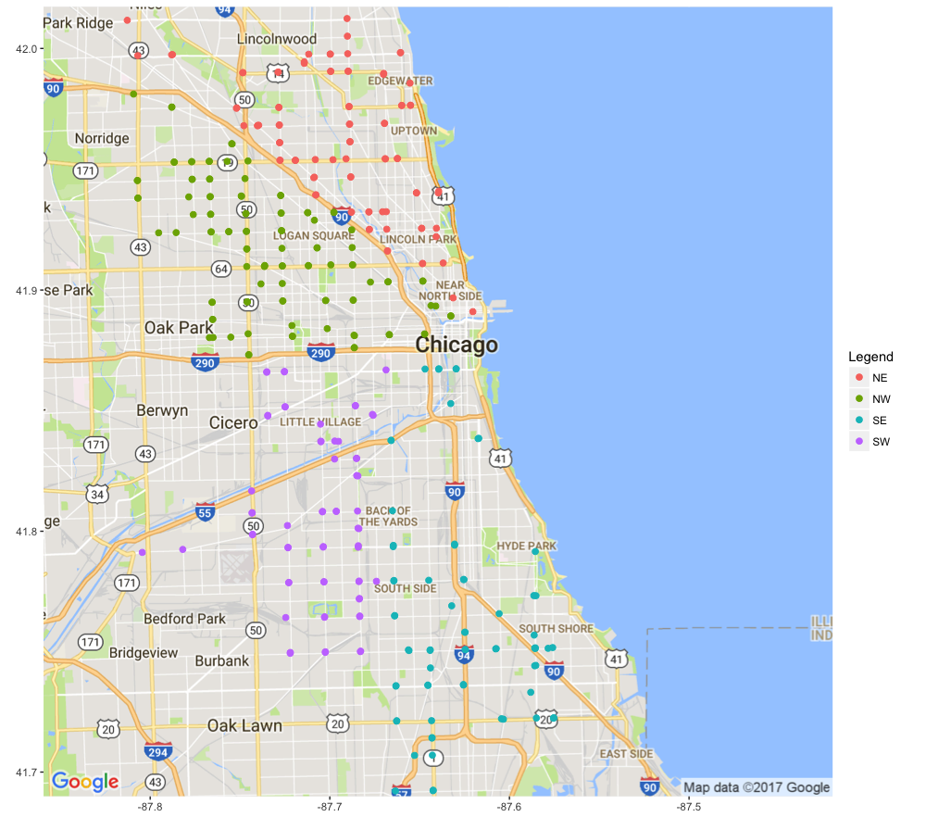
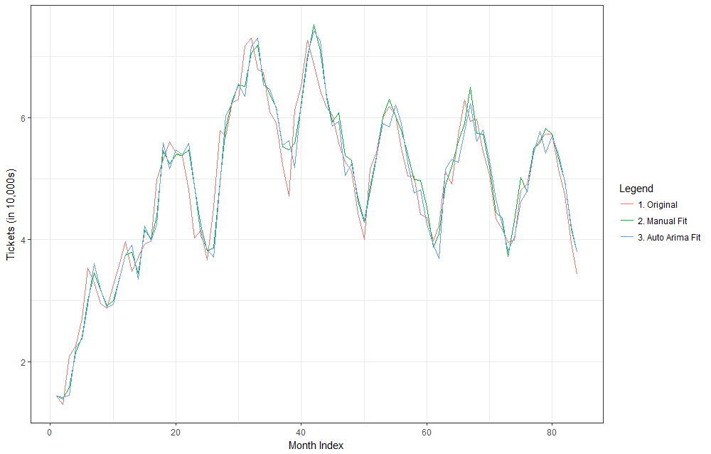
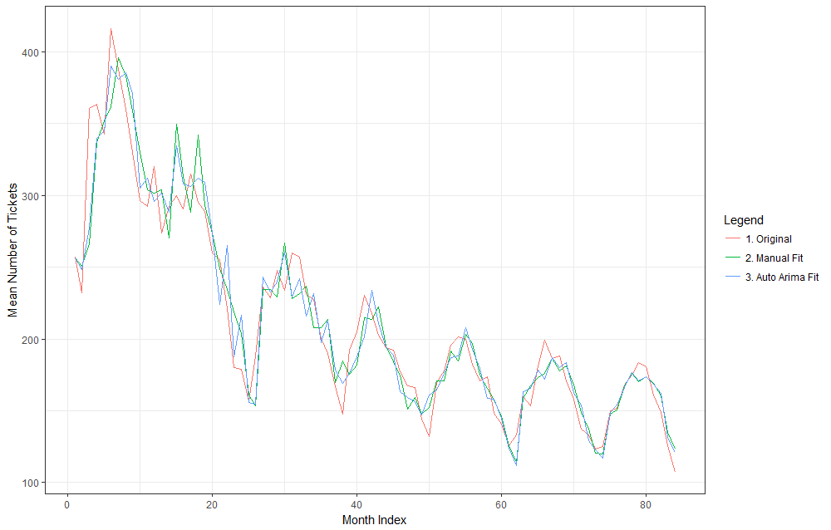
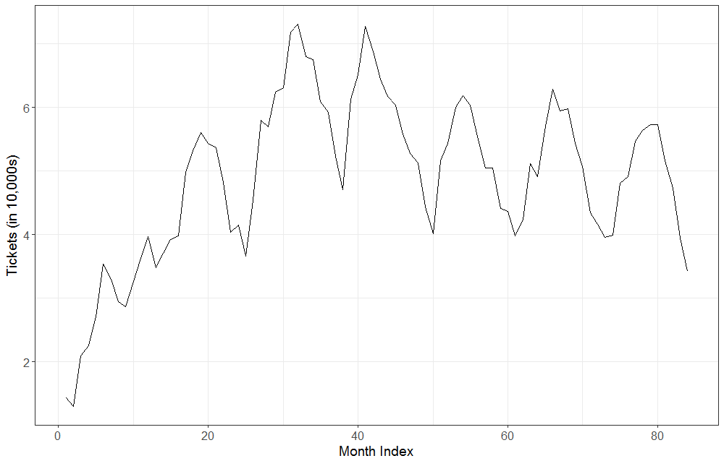
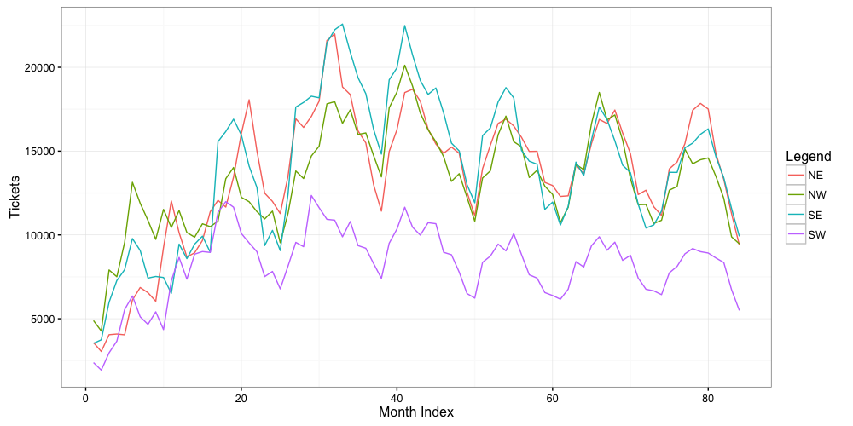
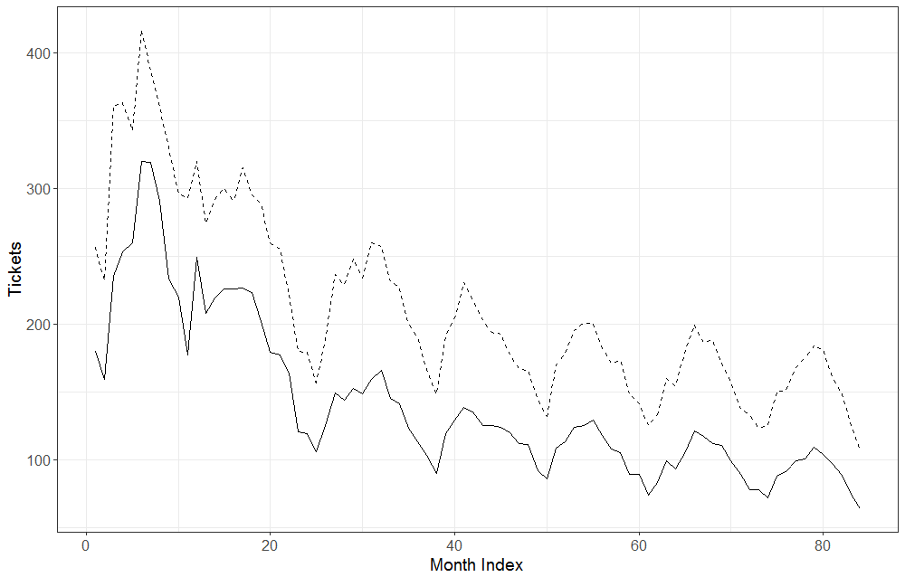
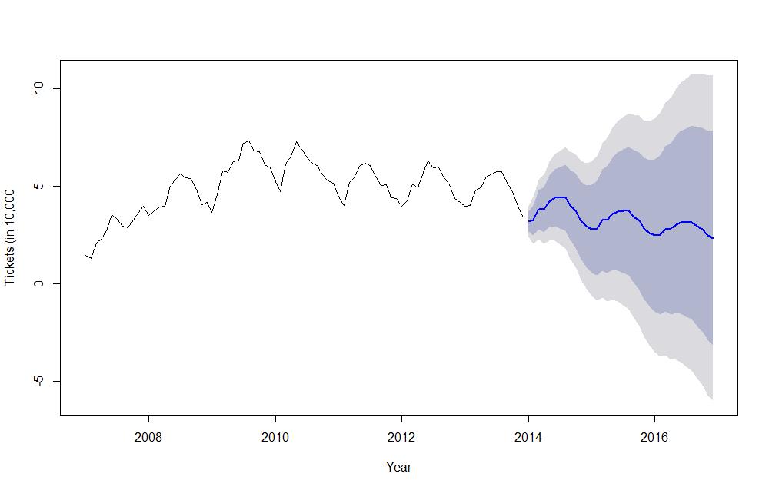
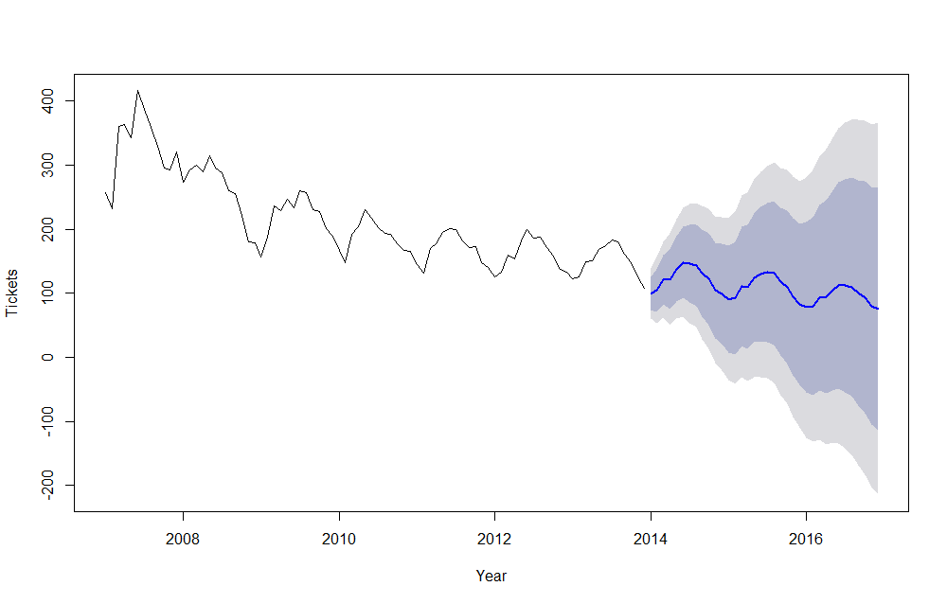
Modeling revenue generated by Chicago's red light cameras
Michael Fagan Department of Mathematics, Statistics, and Computer Science
Primary Objective/Goal
Statistical Analysis (Total)
Statistical Analysis (Mean)
Conclusions
We use time series analysis on data of Chicago’s red light camera system to develop a model that may aid in forecasting the number of tickets issued (and, by extension, the revenue generated) by the system in subsequent years.
We used two methods to produce models: “manually” and the auto.arima function in R’s forecast package.
We use the same methods to produce models for the mean tickets issued per camera.
Chicago’s red light camera system can be reasonably modeled using time series analysis.
Preliminary forecasts suggest a steady, slightly decreasing trend. Intuitively, we believe this trend may flatten in time.
Hence, a red light camera system may provide a municipality with a steady source of revenue.
Manual: ARIMA(0,1,0) x (4,0,0)₁₂
Model Term | Coefficient | Std Error
SAR1 | 0.2745 | 0.1203
SAR2 | 0.0237 | 0.0996
SAR3 | 0.1666 | 0.1323
SAR4 | 0.4205 | 0.1445
Manual: ARIMA(0,1,1) x (2,0,0)₁₂
Model Term | Coefficient | Std Error
MA1 | -0.2588 | 0.1193
SAR1 | 0.3132 | 0.1260
SAR2 | 0.4116 | 0.1405
Time Series Model
The seasonal autoregressive moving average time series model is
Auto Arima: ARIMA(1,1,0) x (2,0,0)₁₂
Model Term | Coefficient | Std Error
AR1 | 0.1694 | 0.1099
SAR1 | 0.4723 | 0.1107
SAR2 | 0.1937 | 0.1205
Auto Arima: ARIMA(2,1,2) x (2,0,0)₁₂
Model Term | Coefficient | Std Error
AR1 | -1.3712 | 0.1622
AR2 | -0.9002 | 0.0949
MA1 | 1.2404 | 0.2348
MA2 | 0.6031 | 0.1733
SAR1 | 0.2838 | 0.1167
SAR2 | 0.4762 | 0.1284
and is denoted ARMA(p,q) x (P,Q)₁₂. If differencing is used, the model becomes a seasonal autoregressive integrated move average model and is denoted ARIMA(p,d,q) x (P,D,Q)₁₂.
Data
Below is a plot of the fitted models against the original time series.
Data provided by the Chicago Tribune consists of over 4 million red light violations spanning from Jan. 2007 through Dec 2013. Over this period, 336 cameras were installed at intersection around the city (far right).
The total number of tickets issued (below) shows a steady climb in year one followed by a relatively stable period with clear seasonal patterns.
Below is the fitted models against the original time series.
The fitted models are roughly in agreement and appear to model the original time series reasonably well. Model selection criterion suggests our “manual” fit is of slightly higher quality, but not enough to offset the more parsimonious auto.arima fit. Below is a preliminary forecast using the auto.arima fit.
These models largely agree and seem to fit the original time series reasonably well. The “manual” fit is of slightly less quality, but far more parsimonious. Below is a preliminary forecast using the “manual” fit.
The mean (dotted) and median number of tickets issued per camera show a steady fall in years one and two followed a more moderate decrease.
Acknowledgments
I would like to thank Dr. Jing Wang for her patience, guidance, and support; Hadley Wickham for all his handy R tools; Tom Reilly and Autobox Forecasting Systems for their generosity; Rob Hyndman and co. for the R forecast package; the Chicago Tribune for providing the data; and my fiancée, Erin, for everything.
Contact Information
Michael Fagan – mfagan3@uic.edu

